Slide 1
Future Challenges &
Opportunities for CRC
Screening in Europe
30 November 2022 9:00 – 12:30 CEST
A virtual event

Slide 2
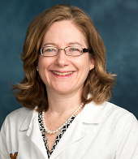
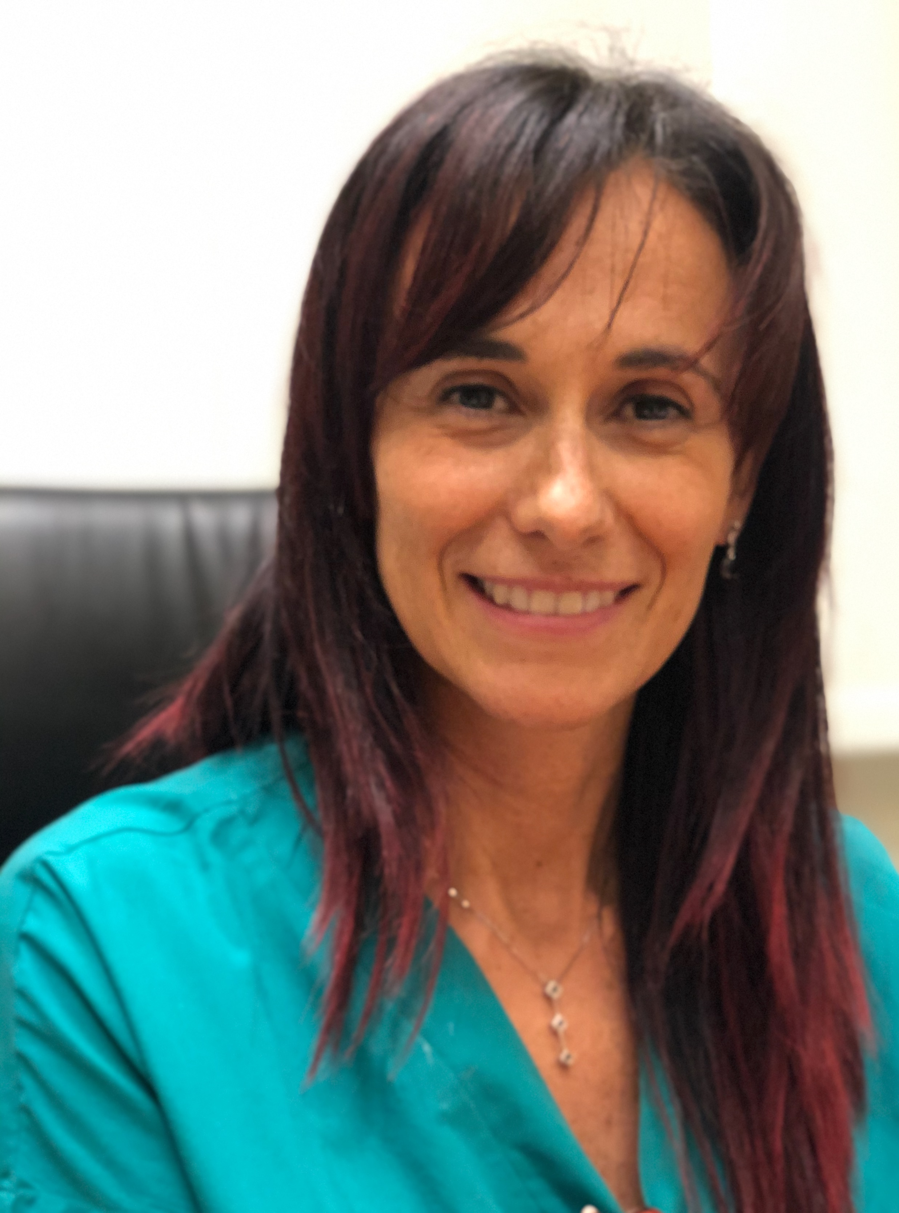
Elena M. Stoffel
MD, MPH
eoCRC Screening: should CRC population screening begin before the age of 50? PROS
Giulia Martina Cavestro
MD PhD
eoCRC Screening: should CRC population screening begin before the age of 50? CONS?

Slide 4
SCREENING: High risk populations
SURVEILLANCE: Average risk population

Slide 5
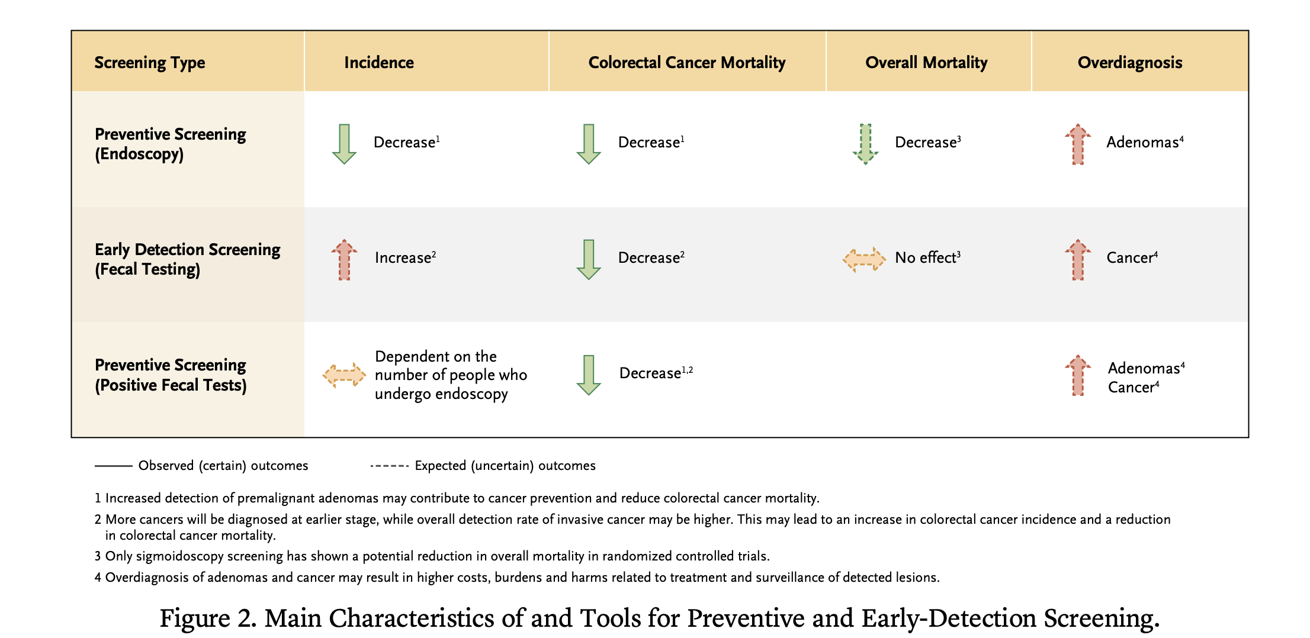

Slide 7
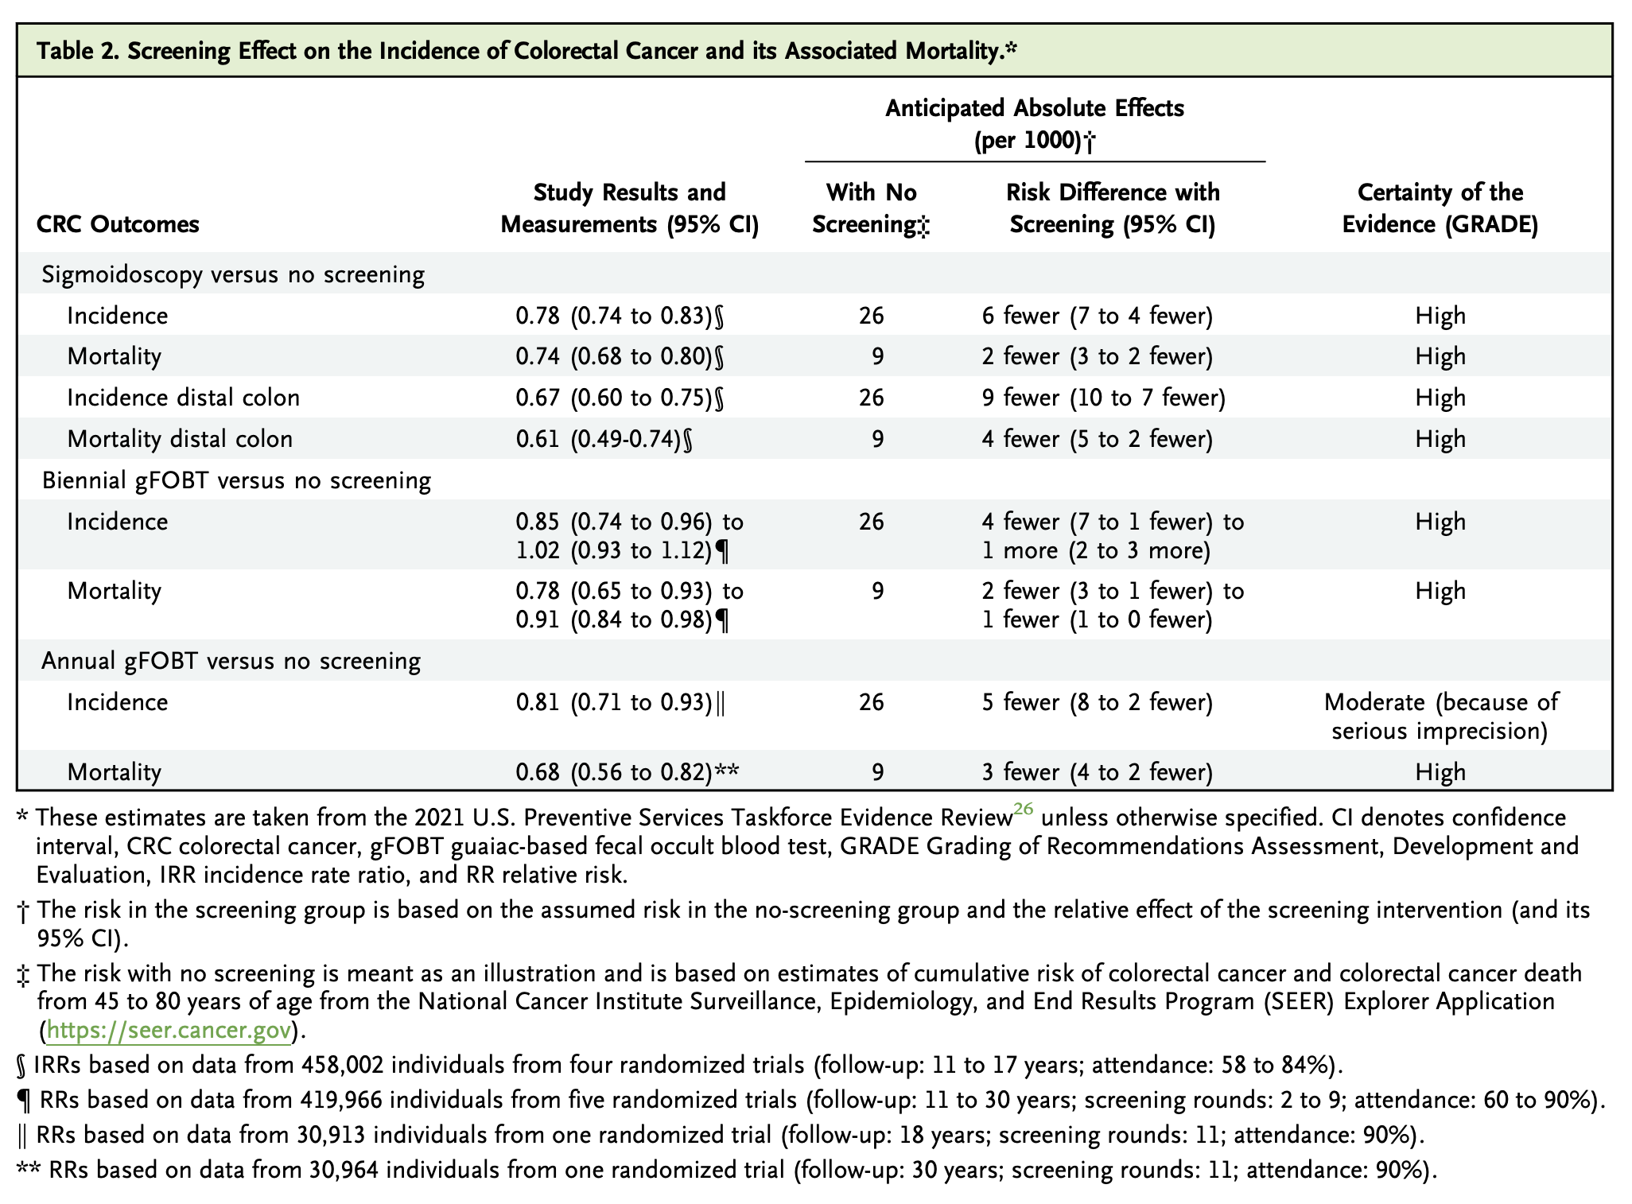

Slide 8
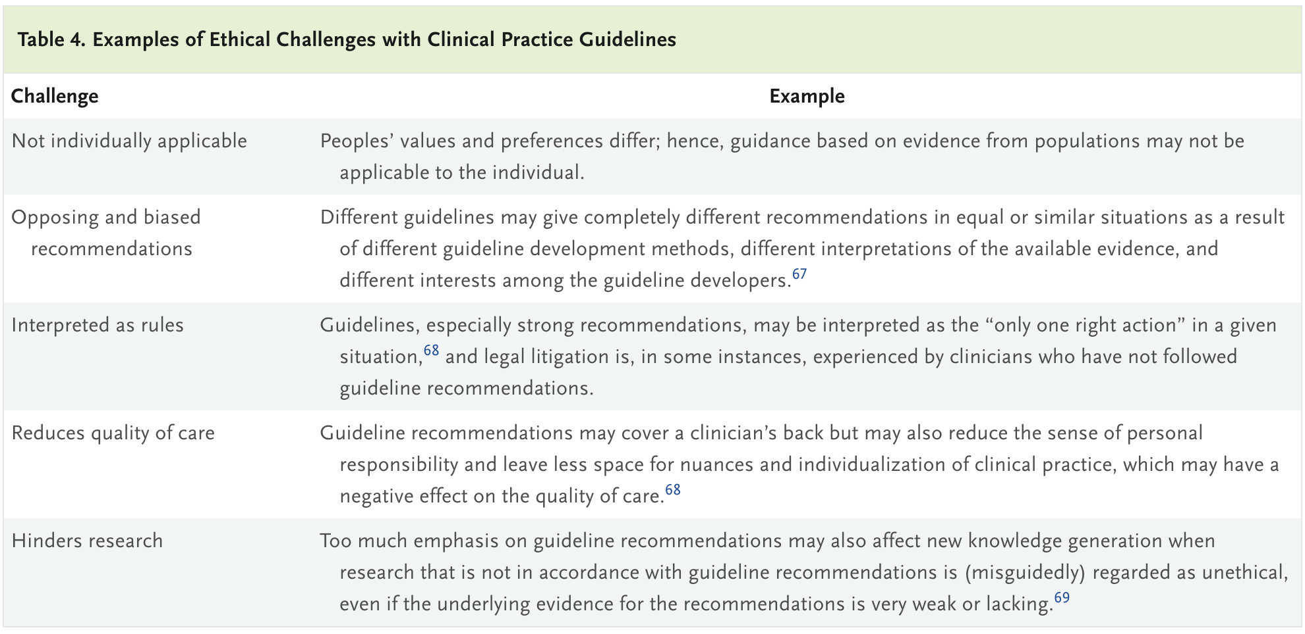

Slide 10
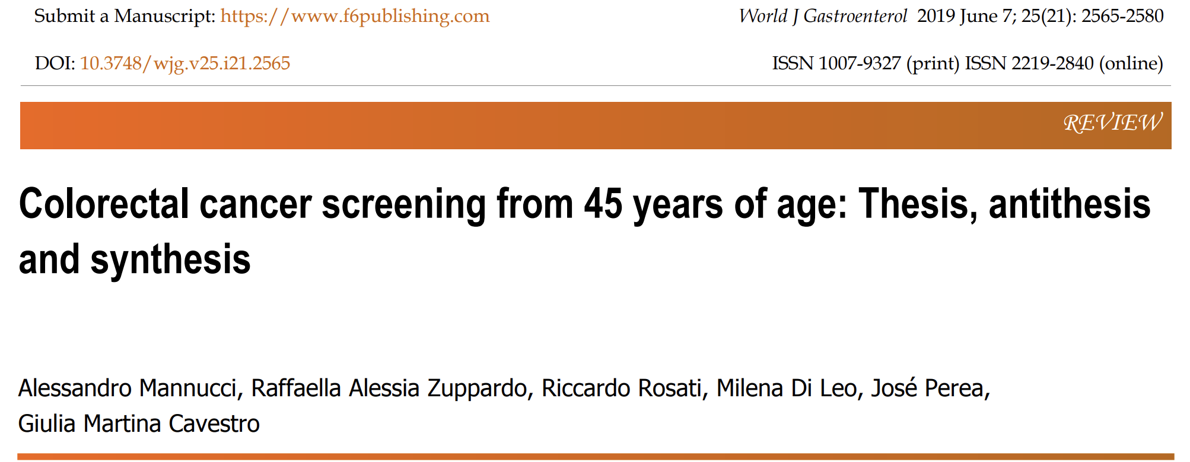
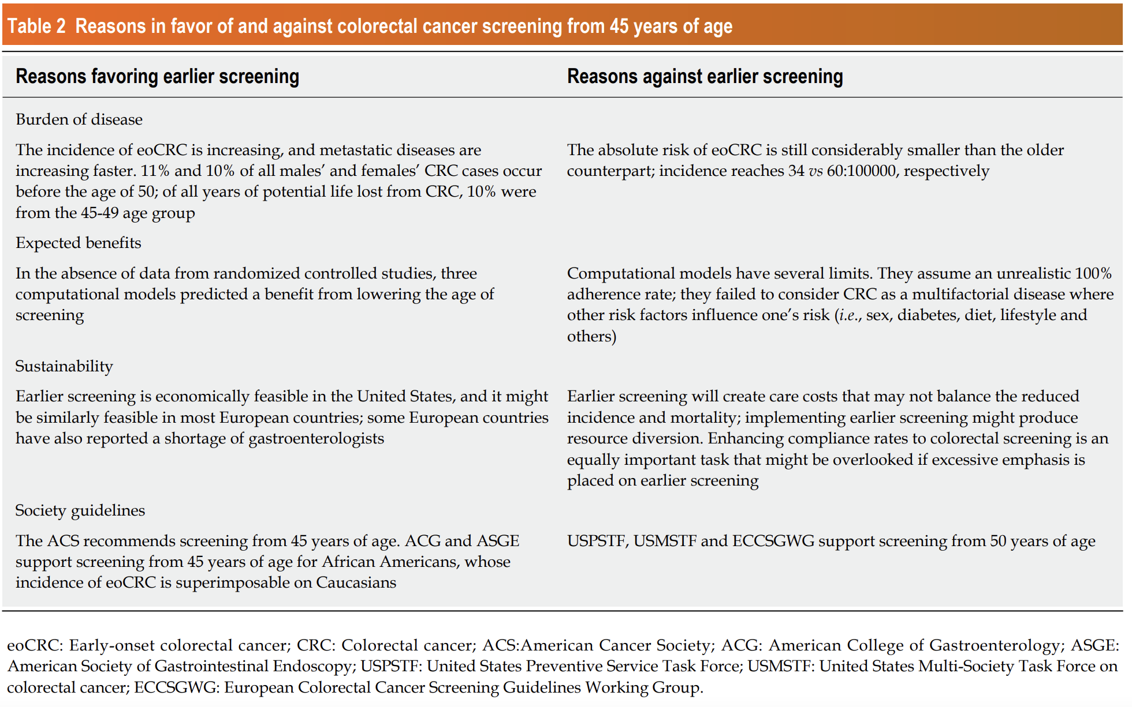

Slide 11
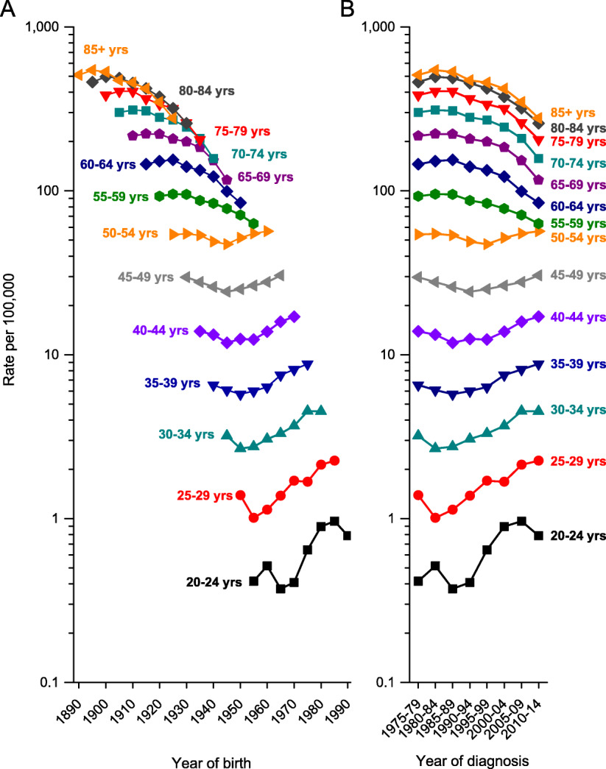
CA A Cancer J Clinicians, Volume: 68, Issue: 4, Pages: 250-281, First published: 30 May 2018, DOI: (10.3322/caac.21457)

Slide 12
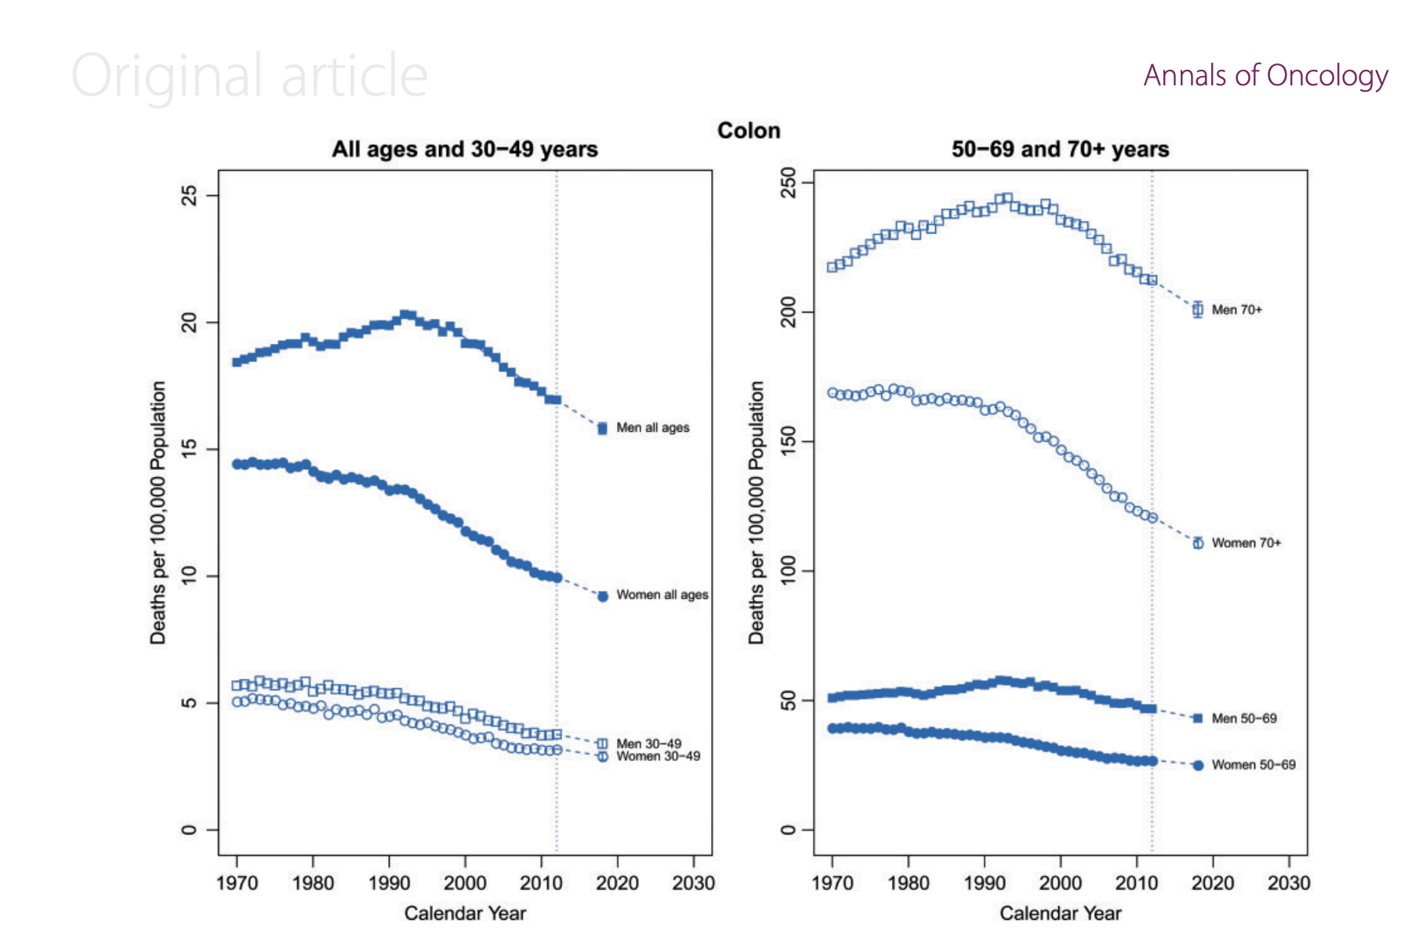

Slide 13
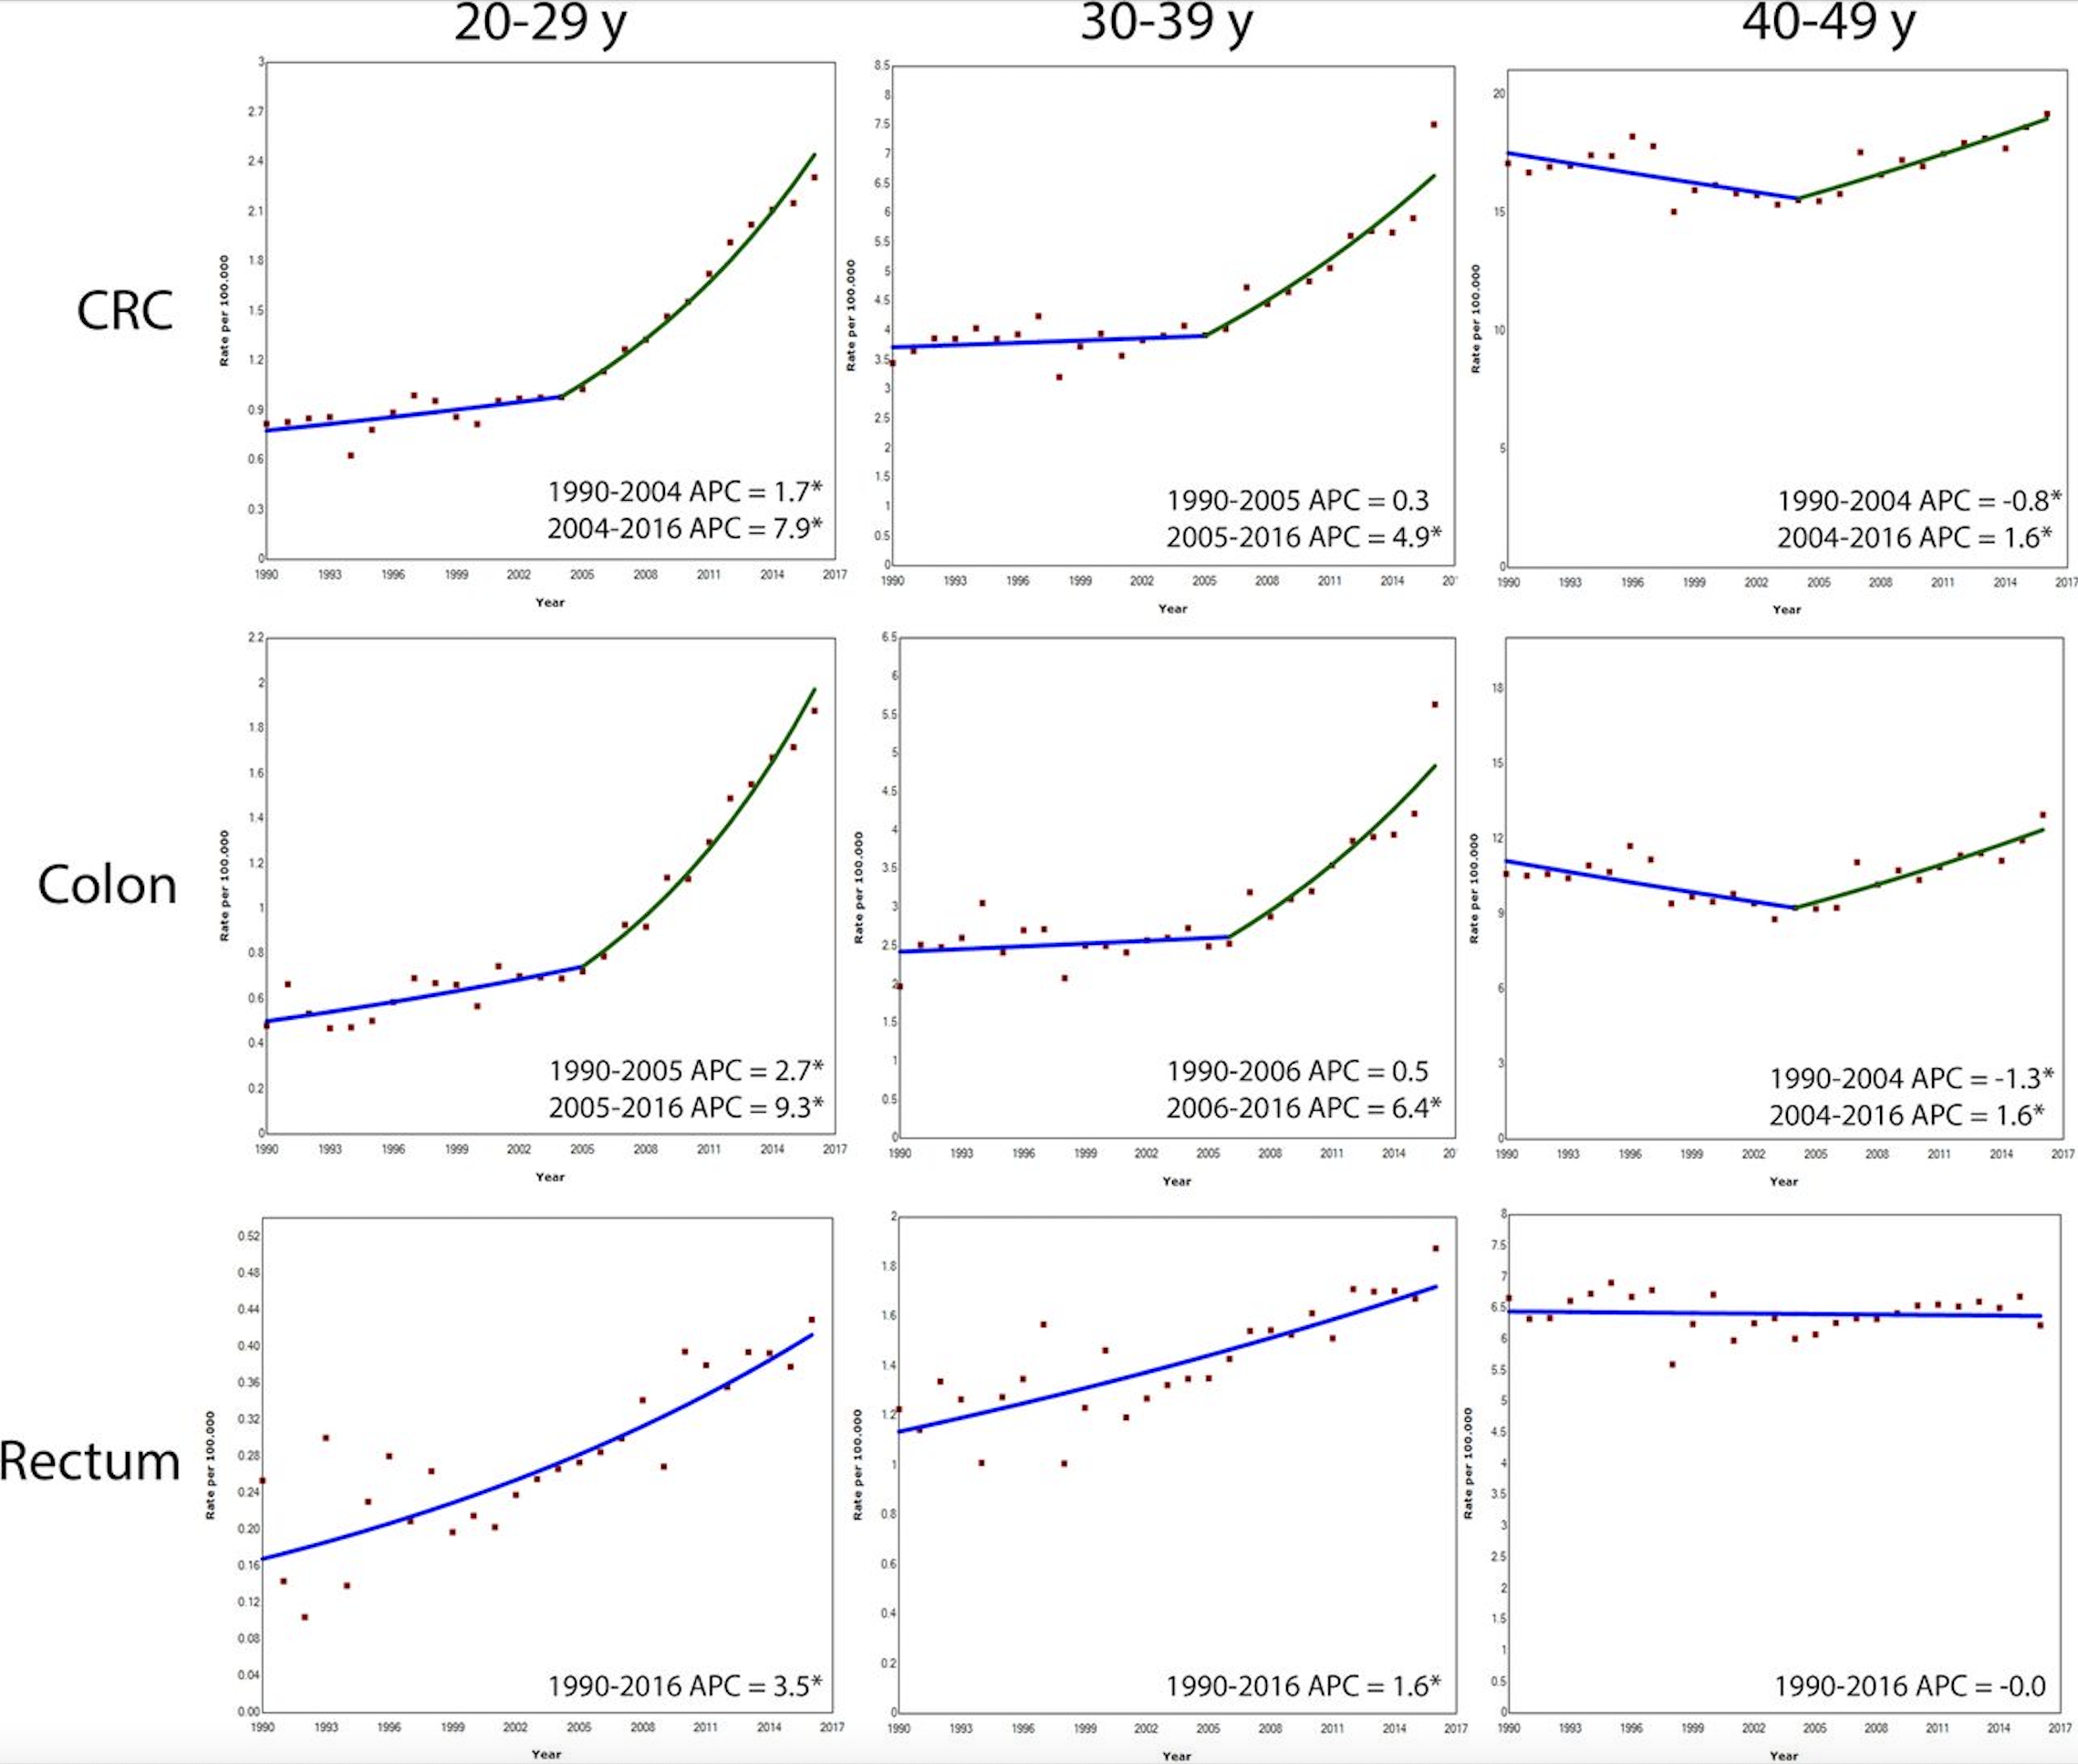
Vuik FER, Nieuwenburg SAV, Bardou M, et al. Gut 2019;68:1820–1826.

Slide 14
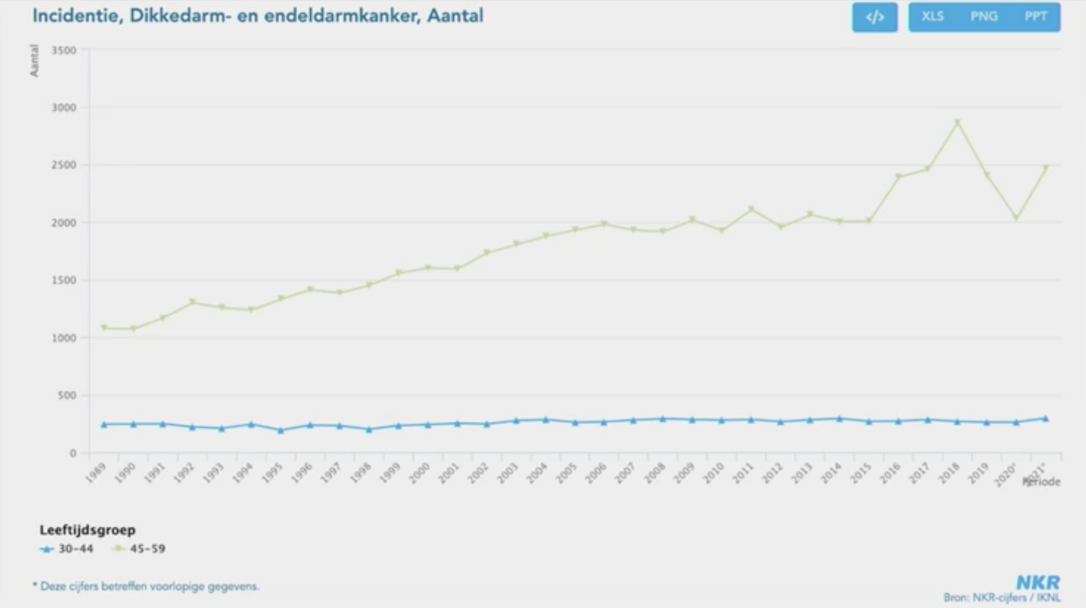
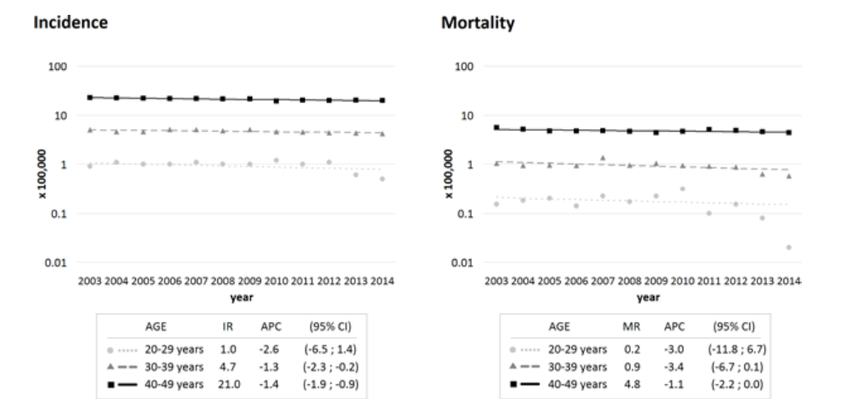
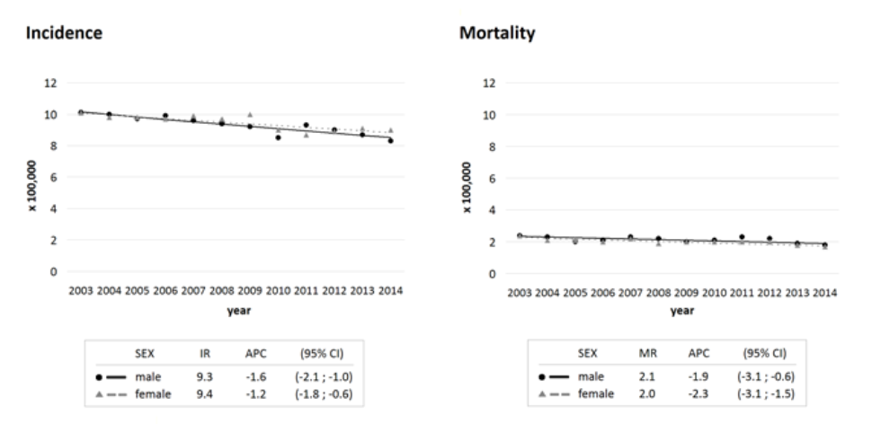
NETHERLANDS
ITALY

Slide 15
MILAN (ITALY)

Slide 17
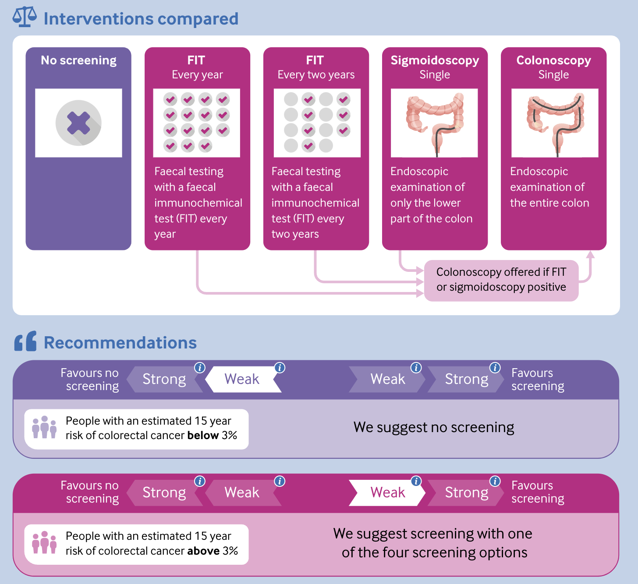

Slide 18
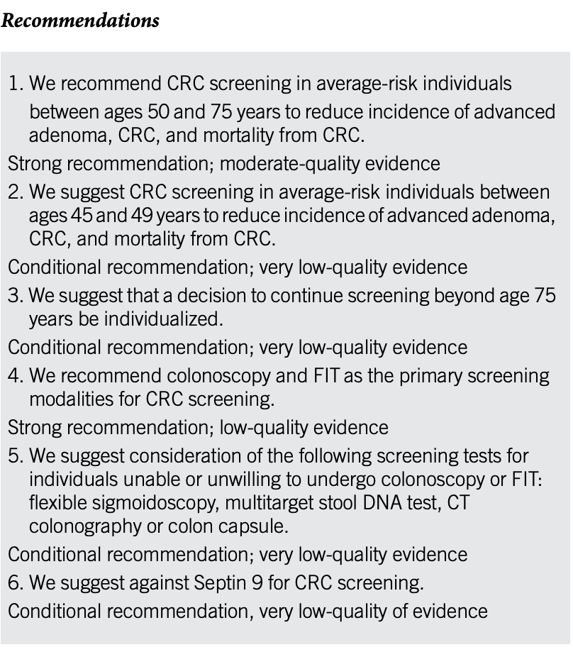

Slide 19
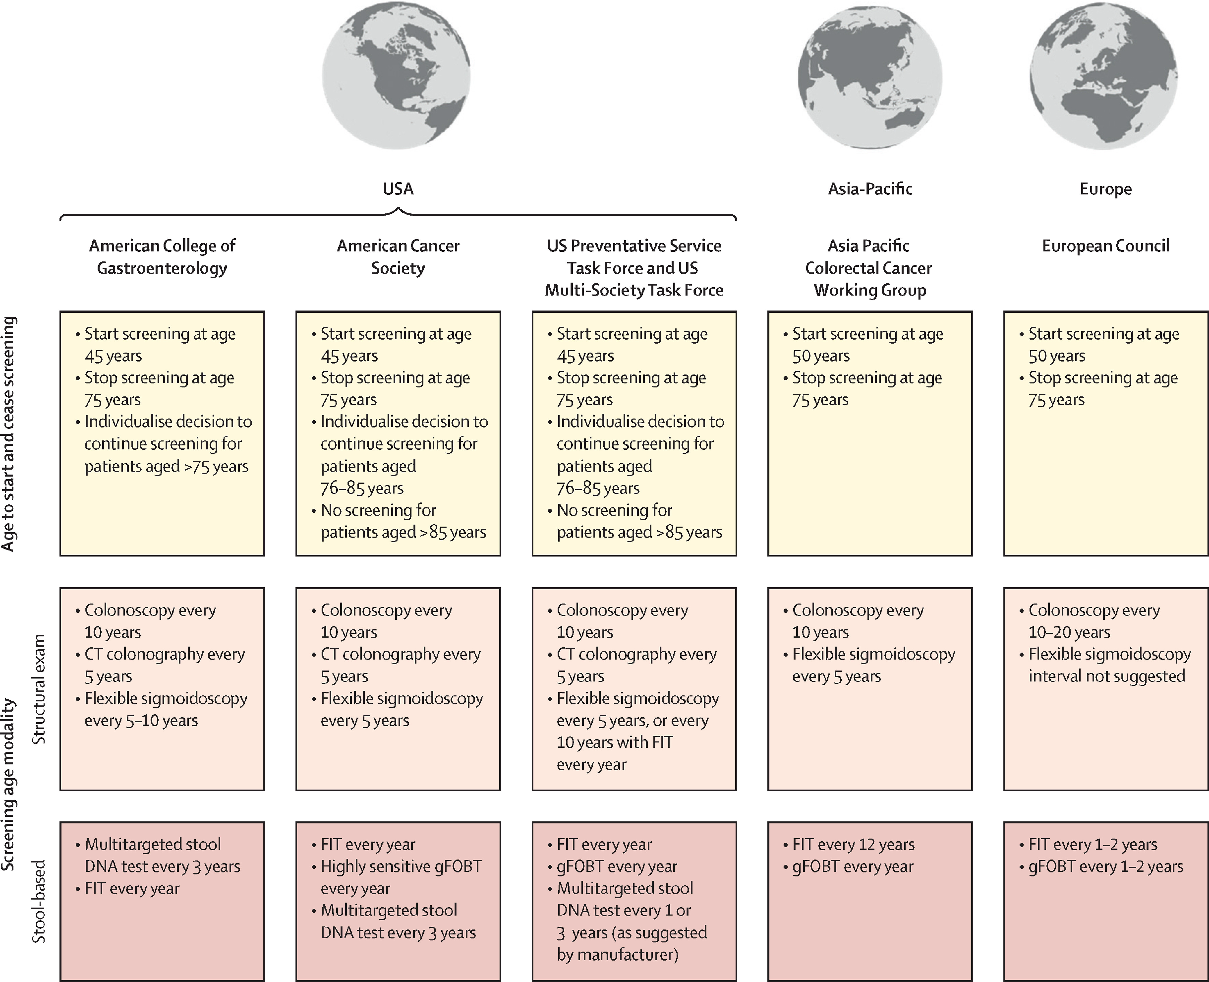
Thank you
Giulia Martina Cavestro, M.D. Ph.D.
Gastroenterology and Gastrointestinal Endoscopy Unit
Vita-Salute San Raffaele University
San Raffaele Scientific Institute
Milan, Italy
cavestro.giuliamartina@hsr.it
Lancet Oncol 2022 Mar;23(3):e116-e128.

